Slide 1

Investigating on the relationship of House prices and Covid 19 confirmed cases in Polk, Florida
DATA512 Project
Matthew Chau

Slide 2

Motivation
Confused by the decreasing rent of my apartment and some of my friend’s apartments during COVID
Seeking to find the relationship between the economy and the COVID 19 cases, house prices could be a good indicator

Slide 3
Problem Statement
Research Question:
Does the pandemic have an impact on the housing prices of Polk, Florida? If so, how was the local housing prices influenced by the pandemic?
Methodology:
Linear Regression for house prices
T-test comparing the slope of house prices before/after Covid
Cross correlation of House prices and Covid confirmed cases

Slide 4
House Prices and Human Centered Data Science
Bias in data collection:
Did not consider the attributes of the houses
Did not consider the newly built houses
Covid data might be biased due to political reasons (US tend to report a falsely higher number whereas some other countries report a falsely lower number than actual)
Requires support from Qualitative research:
Correlation vs Causation – quantitative approaches could not justify this is a causational relationship
Pandemic might not be the only trigger – need to consider impact of other factors

Slide 5
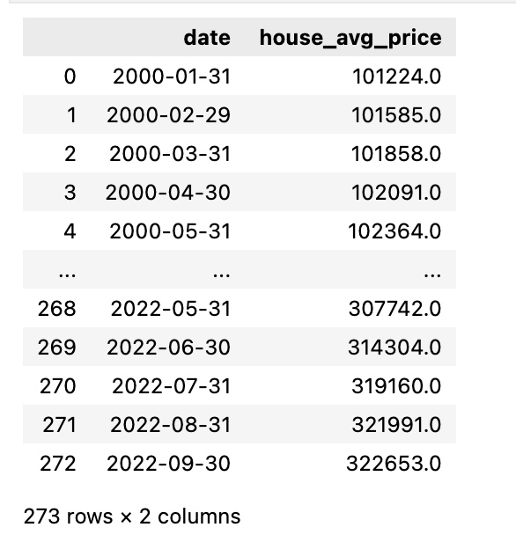
Data
Zillow Home Valued Index
A smoothed, seasonally adjusted measure of the typical home value and market changes across a given region and housing type.
Contains monthly averaged house prices across regions up to a neighborhood granularity level. County level is chosen for this project, and house prices of Polk, Florida is selected from entire US data.

Slide 6
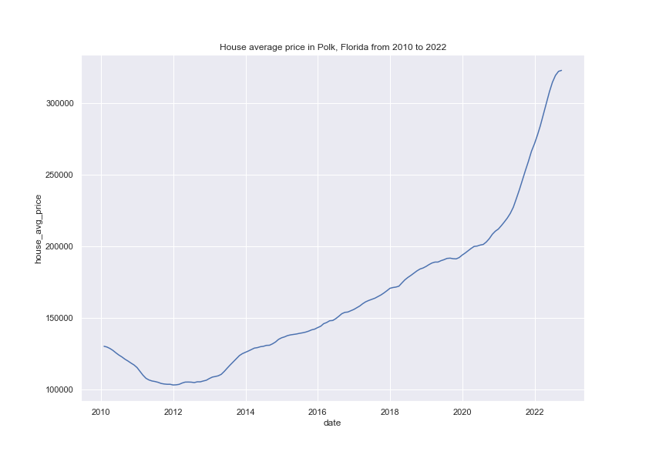
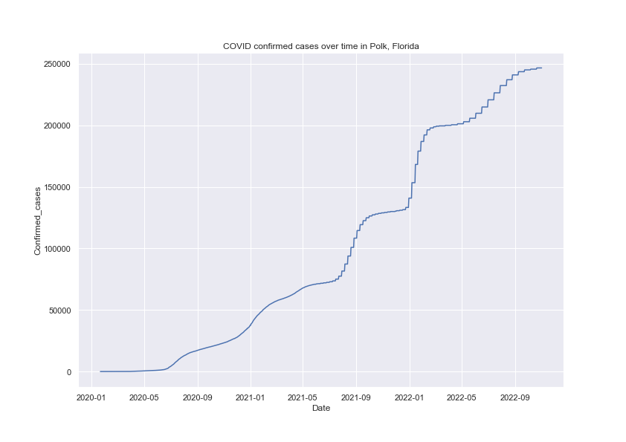
Quick Glance into Data
First Case in Polk
Before Covid
After Covid

Slide 7
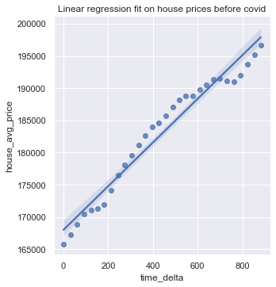
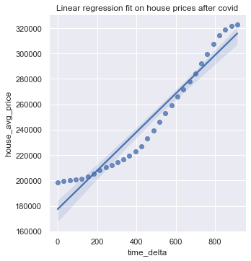
Testing Growth difference before and after Covid Outbreak
Fitted Linear Regression on house prices data both before and after Covid Outbreak
Before Covid:
Slope: 33.91
Y-intercept: 168003.41
R2: 0.96
After Covid:
Slope: 151.56
Y-intercept: 177446.25
R2: 0.94

Slide 8
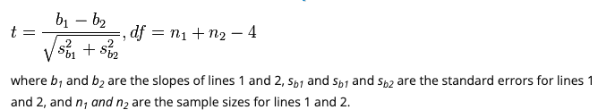
Testing Growth difference before and after Covid Outbreak
Test Statistics
t-Value: 2.66
Degrees of freedom: 57
Probability: 0.0101

Slide 9
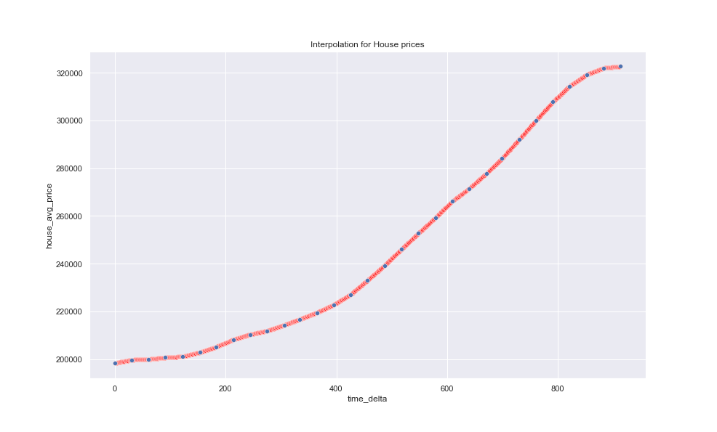
Finding the correlation between the House prices and Covid Confirm Cases
Interpolation
Since the house prices are collected on a monthly basis, and the covid confirmed cases is daily data, we need to make sure they are on the same scale.
The Interpolation method is used instead of linear regression is because it would result in a lower error. Day 15’s housing prices is very likely to lie between day 1’s price and day 30’s price since the change in house prices are very gradual.

Slide 10
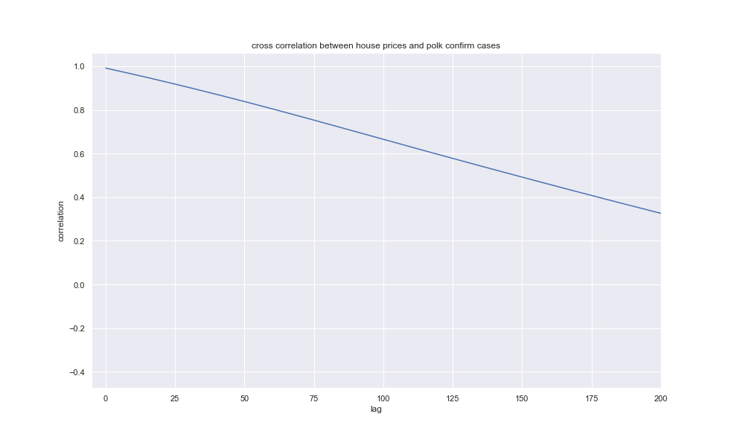
Interpolation and Correlation
Interpolation
The housing prices of Polk and the Covid Confirmed Cases achieves the highest point at lag 0, where the coefficient almost got to 1.0
The Correlation decreases as the lag increases, and appears to be almost perfectly linear

Slide 11
Conclusion and Significance of the Results
Conclusion
The increase rate of housing prices in Polk does have a statistically significant difference between Covid and after Covid.
The change in housing prices have a very strong correlation with the Covid Confirmed cases change in Polk, Florida, and the correlation decreases as the time lag decreases.
Significance
The results suggest that there is a high chance that COVID 19, although might not be the primary one, could be a trigger of the surge in the house prices. If further analysis show that this is the main cause, it could imply that similar pandemics could have similar impacts on the house prices as well.
This brings insights to investors and house owners in Polk, since the strong correlation could imply that there’s a high possibility that when confirmed cases increase rate decreases, the house prices would have a lower increase rate or even decrease.

Slide 12
Future Improvements
Apply the research to US scale
Qualitative analysis on Covid, house prices and potential other infleuncing factors
Investigate on the derivatives/second derivatives of the two variables (rate of change)

